Slide 1
The Olympian Gods

Slide 2
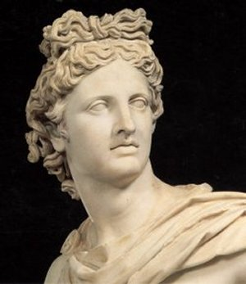
Apollo
Son of Zeus and Leto
God of Music
Twin brother to Artimes
Also god of the sun

Slide 3
Apollo
Inventor of many instruments such as lute. He competed against other gods in competition
His daily task is to ride his chariot across the sky. The wheels are made of the sun and can be seen far and wide.
He is also famous for his oracle of Delphi. He could tell into the future.

Slide 4
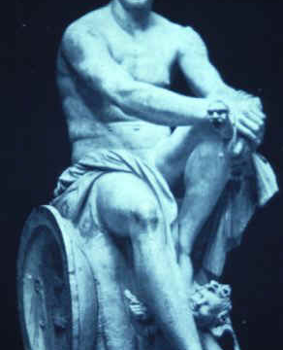
Ares
Son of Zeus and Hera
God of War
Weapon of choice is the shield and the spear
His half sister is Athena

Slide 5
Ares
Ares is considered bloodstained and a coward, qualities that were not thought to be desirable during that time
Once had an affair with Aphrodite. Hephaestus, her husband, publically ridiculed and humiliated him.
He was considered to be one of the more difficult gods to get along with. Because of this, nobody wanted him as his deity.
His animal is the dog.

Slide 6
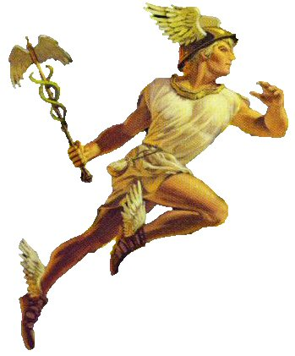
Hermes
Son of Zeus and Maia
The winged messenger. He wears winged shoes as well as a winged hat
God or thieves and commerce

Slide 7
Hermes
Zeus’ personal messenger
Serves as guide to the dead in the underworld
Invented the Lyre as well as pipes and the musical scale

Slide 8
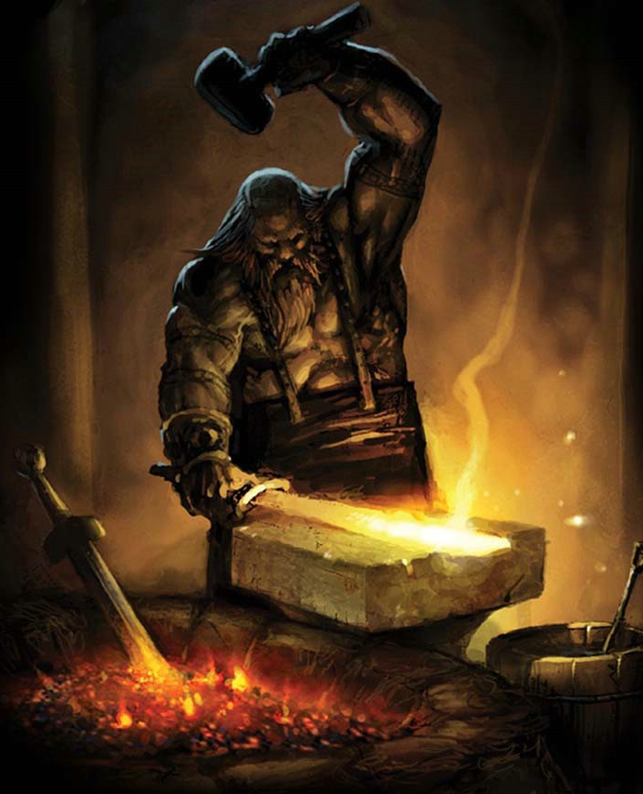
Hephaestus
Son of Zeus and Hera
It has also been said that Hera produced him on his own
Patron god of smiths and weavers
Is married to Aphrodite

Slide 9
Hephaestus
Only one of the gods to be physically ugly
He is also lame. Some believe Zeus hurled him from Mt. Olympus after disagreeing with him. Others believe that Hera threw him into the ocean after being distraught over having an ugly baby and broke his legs
He is thought to be very kind
The volcano is used as his forge

Slide 10
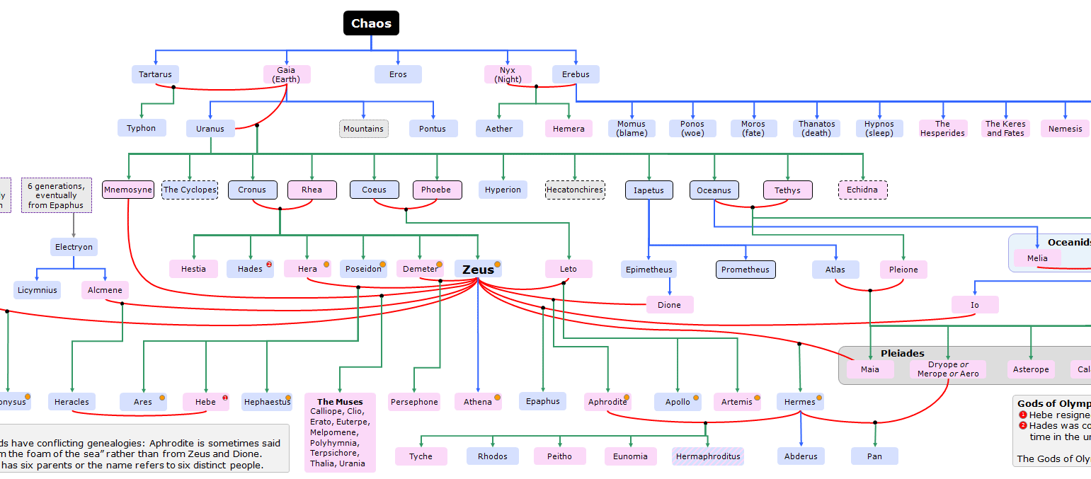
Full Olympian God Family Tree

